Slide 1
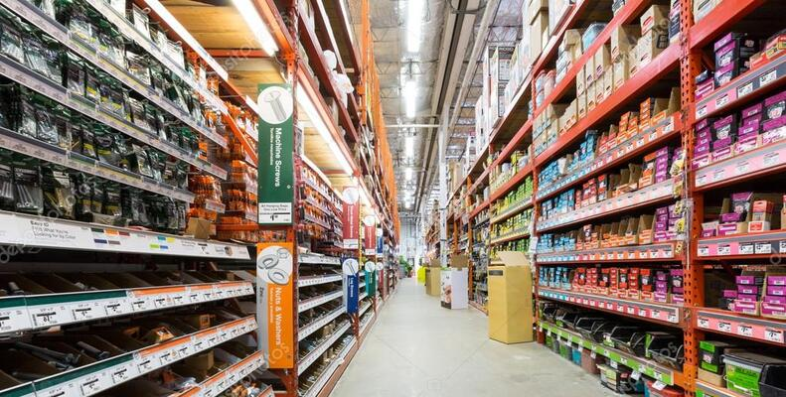
GLOBAL SUPERSTORE SALES ANALYSIS
CREATED BY-
Udit Kumar Shukla
DA/DS 24

Slide 2
STORY TELLING
Global Superstore is a multinational retail company that operates across various regions, offering products in categories like furniture, office supplies, and technology. A deep dive into the data reveals that while North America leads in total sales, Europe outperforms in profitability due to lower shipping costs and fewer returns. Asia, on the other hand, shows strong growth potential, but higher shipping costs and delays hamper profitability. By focusing on optimizing shipping and customer satisfaction, the store can unlock growth opportunities, particularly in underperforming regions and high-demand product categories.
The best-selling products in Global Superstore are primarily technology items like phones and copiers, which generate the highest sales due to their high price points and demand across corporate and consumer segments. Office supplies such as binders, paper, and pens also rank high in quantity sold, thanks to their everyday use and bulk purchases by businesses. Office furniture like chairs and desks perform well, particularly in Europe and North America, where home office setups and corporate expansions drive sales. Despite varying profit margins, these products contribute significantly to the store's overall revenue and growth across regions.
The top profitable products in Global Superstore tend to come from high-margin categories like technology and furniture. Specifically, copiers and phones from the technology category are among the most profitable due to their high selling prices and steady demand from business segments

Slide 3
Insights About Price Fluctuation Over Different Categories and Segments
1. Category-Wise Price Fluctuation:
Technology: High fluctuations around product launches and holiday sales.
Furniture: Stable prices with minor dips during bulk orders or seasonal demand.
Office Supplies: Mostly stable, occasional dips with bulk orders and business discounts.
2. Segment-Wise Price Fluctuation:
Consumer Segment: High sensitivity to holiday sales, experiencing large price drops.
Corporate Segment: Lower average prices due to bulk purchases, fewer fluctuations.
Home Office Segment: Frequent fluctuations, driven by small, regular purchases.
3. Region-Wise Price Fluctuation:
US & Canada: Strong price volatility during holiday seasons like Black Friday.
EMEA: More stable, minor fluctuations during local holidays.
APAC: Moderate fluctuations influenced by local economic conditions and currency.
4. Seasonal Price Fluctuation:
Peak Seasons: Significant price drops during Black Friday, Christmas, etc.
Off-peak Seasons: Stable prices, occasional discounts to clear inventory.

Slide 4
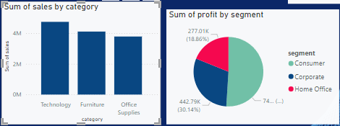
Difference Price Rate Over Each Segment

Slide 5
Insights about Different Region Wise Charts
1. US & Canada:
Highest sales region, driven by a large consumer base.
Major sales spikes during Thanksgiving, Black Friday, and Christmas.
Consumer and Corporate segments lead, with consistent corporate bulk purchases.
2. EMEA (Europe, Middle East, Africa):
Moderate sales, with Europe contributing the most.
Sales peak during regional holidays like Easter and Boxing Day.
Strong sales in Technology and Office Supplies, with stable sales year-round.
3. APAC (Asia-Pacific):
Fastest-growing region with high demand, especially for Technology.
Significant sales increases during Singles' Day and Lunar New Year.
Sales spikes are driven by local festivals and shopping events.
4. Comparative Insights:
Top region: US & Canada dominates overall sales.
Highest growth: APAC shows rapid growth, particularly in technology sales.
Stable sales: EMEA has consistent, steady sales, with fewer large spikes.

Slide 6
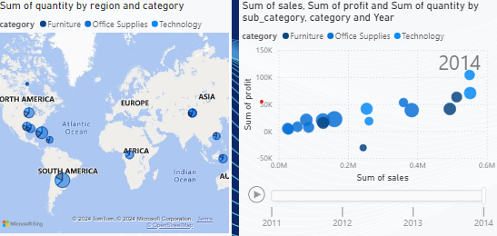
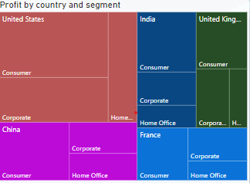
Region & Country Wise Sales Comparison Through Different Maps

Slide 7
Country Wise Sales Distribution Over Profit
Top Performing Countries by Sales and Profit:
United States:
Highest sales and profit contribution.
Strong in Technology and Office Supplies.
India:
High sales, but moderate profit due to competitive pricing.
2. High Profit Margin Countries:
Canada:
Moderate sales with high profit margins driven by bulk corporate orders.
United Kingdom:
High profit margins in Office Supplies, driven by frequent bulk purchases.
3. Countries with Low Profit Margins Despite High Sales:
China:
High sales, especially in Technology, but low profit margins due to competitive pricing.
France:
Moderate sales, but lower profit due to higher operational costs and lower-margin products like furniture.

Slide 8
Compare The Sales With Some Advance Charts As(Gauge & KPI)
Sales Target Monitoring (Gauge):
The gauge chart shows the current sales progress, e.g., at 75% of a $1 million target.
Provides a clear, visual indication of whether regions or categories are on track to meet their sales goals.
Color coding helps quickly identify underperforming areas (e.g., red for regions below 50% of the target).
Overall Sales KPI:
Tracks monthly or quarterly sales (e.g., $1.2 million compared to a $1 million target), providing a real-time status of goal achievement.
Trend lines help analyze if sales are growing or declining, offering actionable insights for management to boost sales in underperforming periods.
By implementing Gauge and KPI visuals on the Global Superstore data, We Can easily track real-time performance across key metrics like sales, profit, and customer segments, allowing for quicker decision-making to meet business objectives.

Slide 9
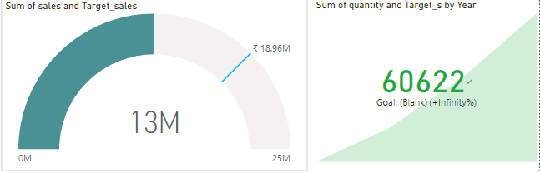
Implementing The Gauge Chart and KPI’s To Show The Trends Over Targeted Sales

Slide 10
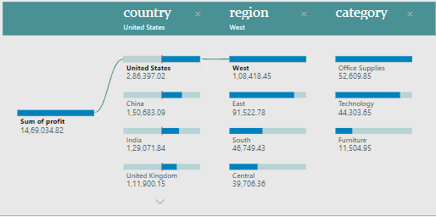
Showing Insights Of Multiple Segments Using Decomposition Tree
Top-performing countries: Identify countries contributing the most to the metric.
Underperforming regions: Highlight regions within countries that show lower-than-expected performance.
Category leaders: Certain product categories dominate overall contributions across regions and countries.
High-impact region-category combinations: Some regions may outperform others for particular product categories.

Slide 11
Some Recommendations To Create Batter Analysis Of This Data
Focus on top-performing countries: Allocate more resources and marketing efforts to the countries contributing most to the target metric.
Improve performance in underperforming regions: Investigate the reasons behind lower performance in specific regions and tailor strategies to boost engagement.
Leverage high-performing categories: Invest in expanding the reach of the top-performing product categories, especially in regions where they dominate.
Tailor offerings to regional preferences: Customize product offerings and promotions to match the preferences of different regions.
Enhance marketing in high-potential region-category combinations: Increase marketing efforts for specific product categories in regions where they show high potential.

Slide 12

THANK YOU
CREATION DATE-> 19/09/24

